Slide 1
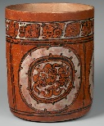
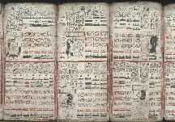
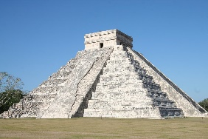
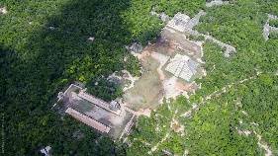
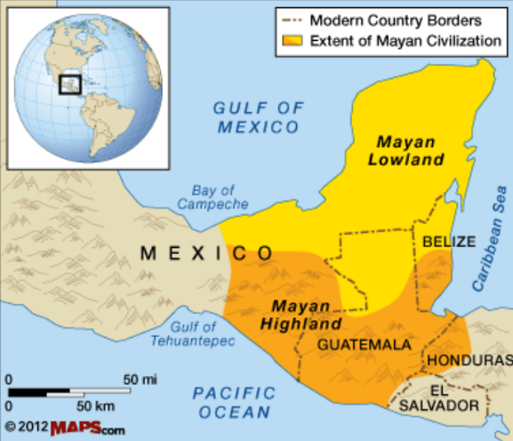
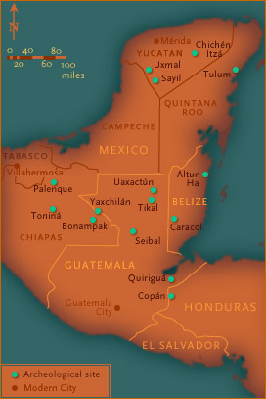
Holy Rosary CVA - History | Phase: UKS2 | Topic: The Maya
​ |  |  | ​ | ​ | ​ | ​ | ​ | ​
2000 BC
Farming villages begin to form in Central America.
1000 BC
The Maya begin to form larger settlements
700 BC
Maya writing is developed
400 BC
The first Mayan calendars are carved into stone.
300 BC
The Maya adopt the idea of a monarchy for their government, now ruled by kings.
100 BC
The first Maya pyramids are built
600 AD
Caracol becomes the capital city-state.
900 AD
Many cities are abandoned due to droughts caused by excessive farming and deforestation.
925 AD
Chichen Itza becomes capital city
1500s AD
The Spanish arrive in South America and destroy the remaining elements of Maya civilisation as part of their conquest.
How do we know about the period? (Artefacts)
Carved pottery and stonework | A variety of pottery and stonework, known as ‘stelae’, depict Mayan life.
Codex | Mayan books written in hieroglyphic script. Only 4 codices remain.
El Castillo | A Mayan pyramid at Chichen Itza, built between 900 – 1200 AD. One of many pyramids still standing.
Other Ruins | At Chichen Itza, for example, these include the great ball court, temples and platforms.
Prior Knowledge
- The following historic eras: Pre-historic Britain (up to 43AD), Ancient Egypt (3150 – 30 BC), who built pyramids and wrote using hieroglyphics, Ancient Greece (1200 – 146BC), Anglo-Saxons & Vikings (410-1066AD). - Central America is part of North America and lies between USA and South America. - A tropical climate is usually warm and wet throughout the year.
By the end of this Unit, I will know…
- That the Mayans were a group of City States that traded with each other. - How the environment affected Mayan settlements and society. - The societal structure of nobles, commoners, serfs and slaves. - That the Mayans believed in life cycle stages that lead to the afterlife. - Which modern day countries the Mayan civilisation covered. - The environmental features of Central America.
Key vocabulary – Society
City State | A city that, with its surrounding territory, forms an independent state.
Commoner | The societal level of farmers, servants and other manual jobs.
Noble | The societal level of rulers, priests, government officials and other administrators.
Serf | The societal level of peasants, working the land of nobles and without anything of their own.
Slave | The lowest societal level, usually orphans, war prisoners, criminals of children of slaves.
Society | The people living together in a more or less ordered community.
Trade | The action of buying and selling goods and services.
Topic vocabulary
Cacao & Maize | Important food sources and trade commodities. There was even a Maize God.
Itzamna | The Creator God and Ruler of the Heavens.

